Slide 1



Hello and welcome. Today, I will be presenting an overview of our company's sales performance for 2010 and 2011. I'm grateful for the chance to delve into this data and uncover meaningful insights regarding the store's performance. Your questions were invaluable, guiding me toward the specific insights you’re interested in exploring.
Presentation By: Aditya Prakash

Slide 2
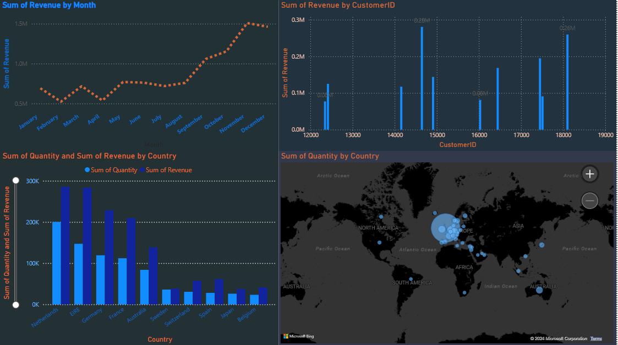

Thought Process
I want to assure you that I meticulously followed all the steps to ensure this analysis is precise and reliable.
I cleaned the provided data by removing any negative values in the Unit Price and Quantity columns and applied the necessary filters for all visualizations.

Slide 3
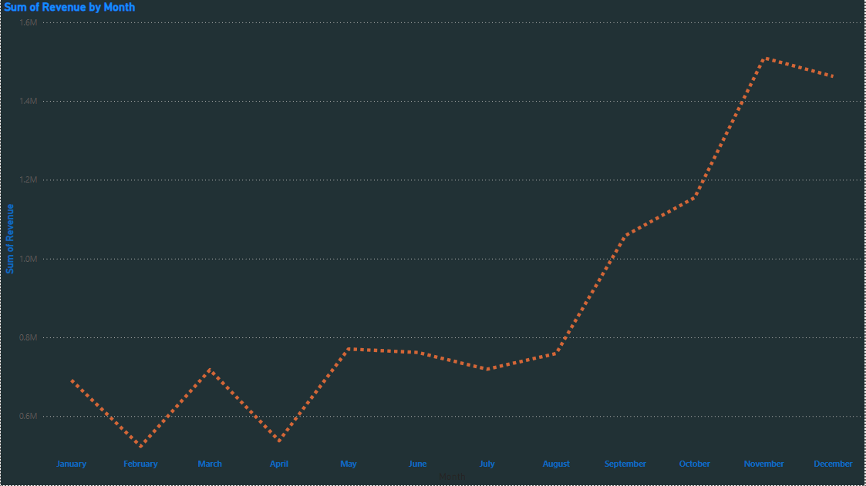
Revenue By Month
During the first eight months, monthly revenues remained stable, averaging $685,000. Starting in September, we saw a substantial rise, with revenue reaching a peak of $1.51 million in November. This reflects an average increase of 21.18% from August to November. The trend from August to December clearly illustrates the impact of seasonality on retail store sales.

Slide 4
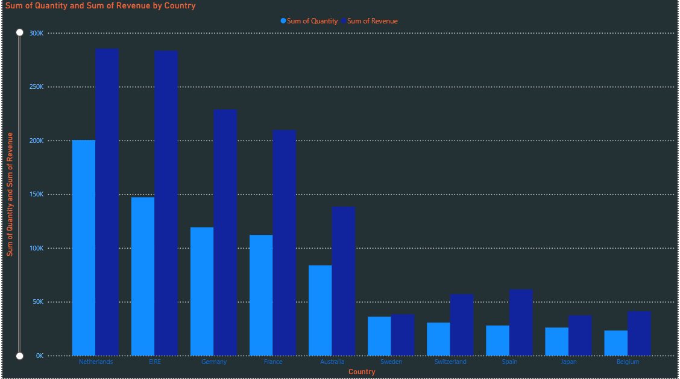
Top 10 Country By Revenue And There Quantity.
This chart highlights the top 10 countries by revenue and the quantities purchased, excluding the United Kingdom. There is minimal variation between revenue and quantity sold, indicating strong purchasing power in these countries. These regions hold significant potential for increased revenue, suggesting that management should prioritize them in marketing strategies.

Slide 5


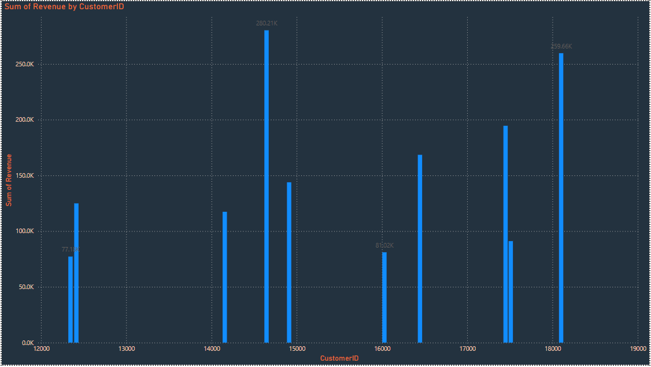
Top 10 Country By Revenue
The chart reveals minimal variation in revenue among the top 10 customers, with an average difference of 15.8%. By focusing on strengthening relationships with these customers, the company can enhance loyalty and retention, ultimately boosting sales and revenue.

Slide 6
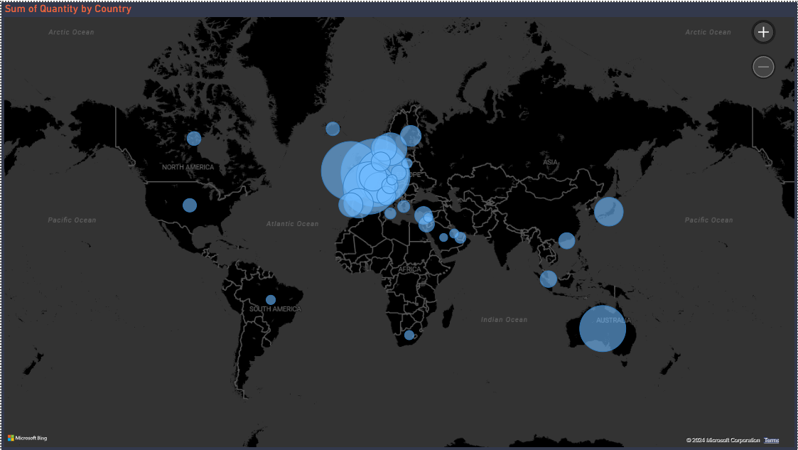
Revenue By Country
﻿
The map chart concludes by comparing the places that have produced the greatest revenue to those that have not.
The map also reveals that the majority of sales occur only in the European zone, with only a small number in the American region Along with Russia, there is no market for the items in Africa or Asia.
The company can concentrate on the European market more and dive deeper into countries in the region to come up with strategies that will maximize sales from each country in the region alongside Australia and Japan.

Slide 7
Recommendations
Develop strategies to stock and promote seasonal products to capitalize on peak demand periods.
Conduct an in-depth analysis of high-demand products during low-sales months to create targeted marketing strategies.
Explore product types and their revenue contributions by region to guide region-specific marketing efforts.
Consider offering incentives to top revenue-generating customers to enhance relationships and loyalty.
Focus on strategies to improve market positioning in the European market, which shows significant growth potential.

